Slide 1
Muscles Continued
Pages: 190-194

Slide 2
Skeletal Muscle Action
Dependent mostly on the kind of join it is associated with and the way the muscles attaches on either side of that joint.
Origin:
Immovable end of a muscle
Insertion:
Movable end of a muscle
During contraction, insertion is pulled towards origin
Some muscles have more than one origin or insertion
Ex. Biceps brachii

Slide 3
Interaction of Skeletal Muscles
Almost always function in groups
Prime Mover:
Provides most movement
Synergists:
Muscles that contract and assist the prime mover
Antagonists:
Resist a prime mover’s action and causes movement in the opposite direction.

Slide 4
Major Skeletal Muscles
Name of muscle is often describes the muscles:
Relative size
Shape
Location
Action
Number of attachments
Direction of its fibers
Examples: Pectoralis Major-of large size located in the pectoral region, Deltoid: shaped like a delta or triangle, Extensor digitorum: extends the digits

Slide 5
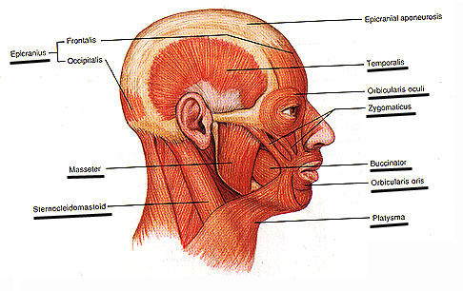
Muscles of Facial Expression
Responsible for expressions of surprise, sadness, anger, fear, disgust, and pain
Include:
Epicranius
Composed of two parts: Frontalis and Occipitalis
Orbicularis oculi
Buccinator
Zygomaticus
Platysma

Slide 6
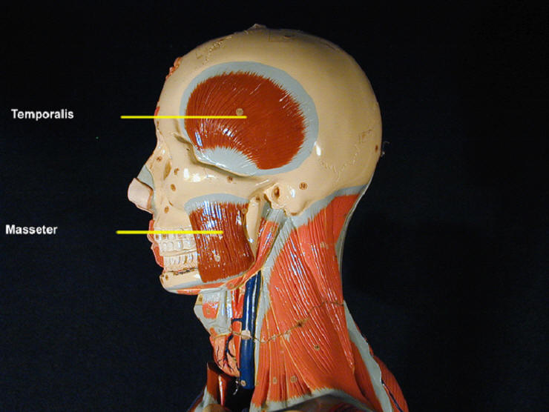
Muscles of Mastication
Attached to mandible and produce chewing movements
Include:
Masseter
Temporalis

Slide 7
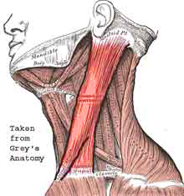
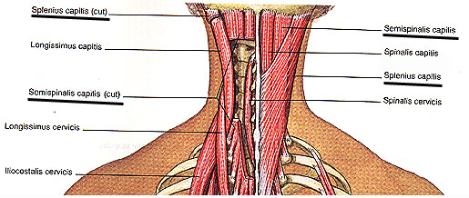
Muscles That Move the Head
Flex, extend and rotate
Include:
Sternocleidomastoid
Splenius capitis
Semispinalis capitis

Slide 8
Action Origin Insertion
Please use table 8.3, 8.4 and 8.5 to fill out your AOI word document.

